Slide 1
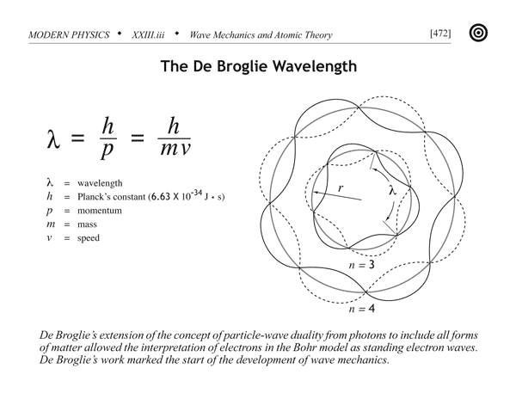
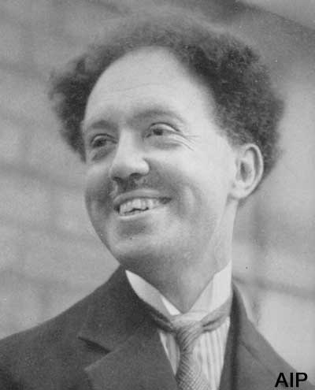
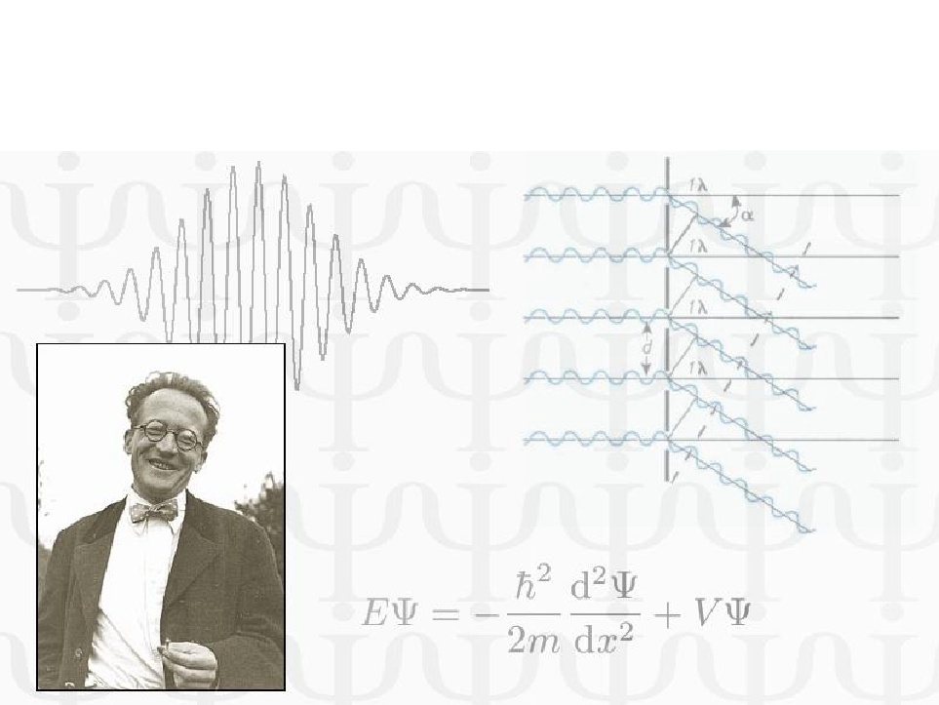
QUANTUM MECHANICS
UNIT II Quantum Mechanics
Lecture-5

Slide 2
WAVE FUNCTION (ψ) de
In case of electromagnetic waves, the electric and magnetic fields vary periodically, whereas in sound waves, pressure varies periodically.
Similarly, in water waves the height of water surface varies periodically.
Now, one can ask what varies in matter waves.
In matter waves, a quantity called wave function, denoted by ψ, varies.
Schrödinger described the amplitude of matter waves in terms of wave function ψ. Wave function ψ (x, y, z) is a complex quantity, which gives the idea of the probability of finding the particle (to which it is concerned) in a particular region of space.

Slide 3
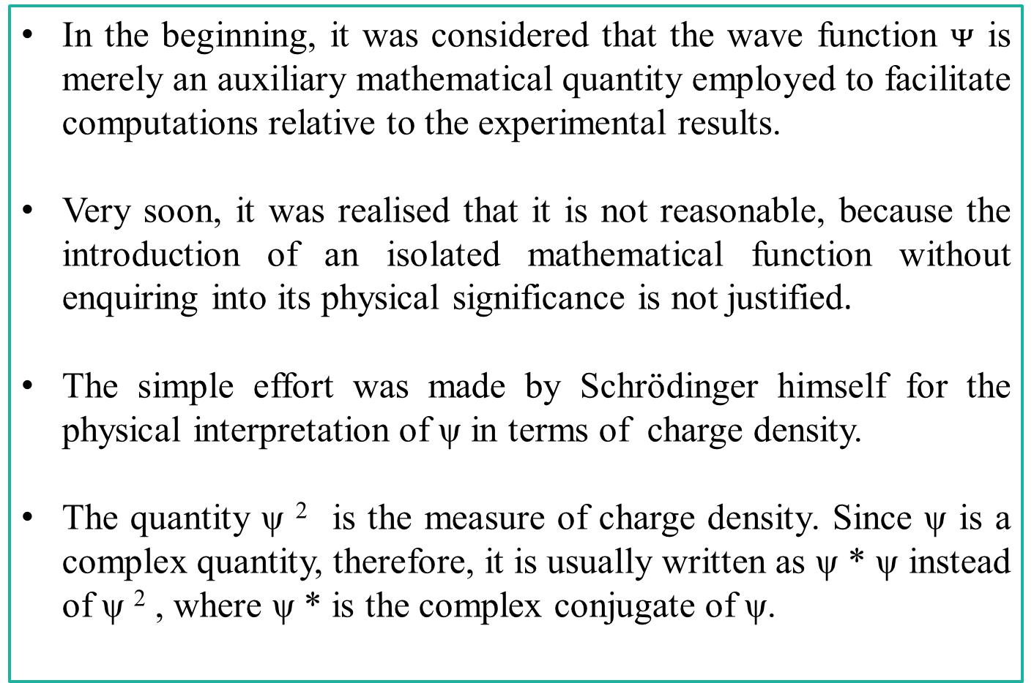
PHYSICAL SIGNIFICANCE OF WAVE FUNCTION (ψ)
In the beginning, it was considered that the wave function $ᴪ$ is merely an auxiliary mathematical quantity employed to facilitate computations relative to the experimental results.
Very soon, it was realised that it is not reasonable, because the introduction of an isolated mathematical function without enquiring into its physical significance is not justified.
The simple effort was made by Schrödinger himself for the physical interpretation of ψ in terms of charge density.
The quantity ψ ² is the measure of charge density. Since ψ is a complex quantity, therefore, it is usually written as ψ * ψ instead of ψ ² , where ψ * is the complex conjugate of ψ.

Slide 4
PHYSICAL SIGNIFICANCE OF WAVE FUNCTION (ψ)
It has been observed that in some cases, ψ is appreciably different from zero in some finite region known as wave packet.
Now, the natural question arises “Where is the particle in relation to the wave packet?” .
In view of the answer of this question it has been suggested that ψ ψ * = | ψ | ² gives the probability of finding the particle in the state ψ i.e., ψ ² is a measure of probability density.

Slide 5
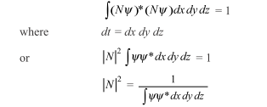
CONDITION FOR NORMALIZATION OF WAVE FUNCTION
If ψ is not a normalized wave function and it is the solution of a wave equation, then (N ψ) will also be the solution of the same wave equation, where N is a constant quantity.
Now, the next problem arises to select the proper value of N, such that the new wave function is a normalized function.
For the normalization of this new wave function, it must satisfy the following requirement:
Where |N| is termed as the normalization constant and N ψ is known as the normalized wave function.

Slide 6
SCHRÖDINGER WAVE EQUATION
Schrödinger worked extensively on wave mechanics, used to deal with the matter waves.
He suggested two important equations for the motion of matter waves.
TIME-INDEPENDENT SCHRÖDINGER WAVE EQUATION
TIME-DEPENDENT SCHRÖDINGER WAVE EQUATION

Slide 7
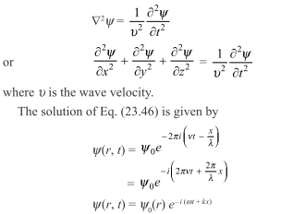
TIME-INDEPENDENT SCHRÖDINGER WAVE EQUATION
Let ψ (x, y, z) be the wave displacement for the matter wave at any time t. ψ is the wave function, which is a finite, single-valued, and periodic function. The classical differential equation of a wave motion is

Slide 8

TIME-INDEPENDENT SCHRÖDINGER WAVE EQUATION Contd..
Where ψ₀ is the amplitude of the wave at the considered point and is the function of position only [i.e., (x, y, z)].
Differentiating above equation twice with respect to t, substituting this value in parent equation and using the de-Broglie hypothesis we get we get
If E and V are the total energy and the potential energy of the particle, respectively, then its kinetic energy is given as

Slide 9


TIME-INDEPENDENT SCHRÖDINGER WAVE EQUATION Contd..
Substituting this value of m ² v ² in above Eq. , we get
This Equation is the Schrödinger time-independent wave equation.

Slide 10

TIME-DEPENDENT SCHRÖDINGER WAVE EQUATION
Time-dependent Schrödinger equation may be obtained by eliminating E from time independent wave equation
From the definition of ψ we know that
Differentiating the above equation with respect to t, we get

Slide 11
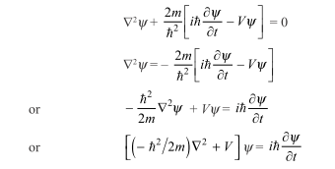
TIME-DEPENDENT SCHRÖDINGER WAVE EQUATION
Substituting the value of E ψ in time independent wave equation we get
Equation we get is known as time independent wave equation. Sometime it is also expressed as
Hψ = E ψ

Slide 12
EIGENVALUES AND EIGENFUNCTIONS
In an atom eigenvalues correspond to the energy values associated with different orbits in the atom.
Thus, we can conclude that Bohr’s postulate, according to which the various energy levels exist in an atom, is the direct consequence of the wave mechanical concept.
The solution of the wave equation for these definite values of E gives the corresponding values of the wave function ψ, known as eigenfunctions.

Slide 13
EIGENVALUES AND EIGENFUNCTIONS
Only those eigenfunctions have physical significance, which satisfy certain conditions listed as follows:
(i) They must be single-valued functions.
(ii) They should be finite.
(iii) They should be continuous throughout the entire space under consideration.
(iv) In other words, we can say that they should be continuous for all possible values of coordinates (x, y, z), including infinity.

Slide 14

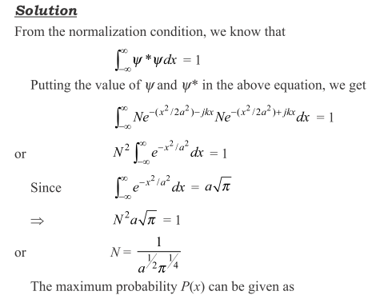
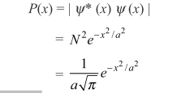
Example-1 The wave function of a free particle in normalized state is represented by
Calculate the normalization factor N and the maximum probability of finding the particle.

Slide 15
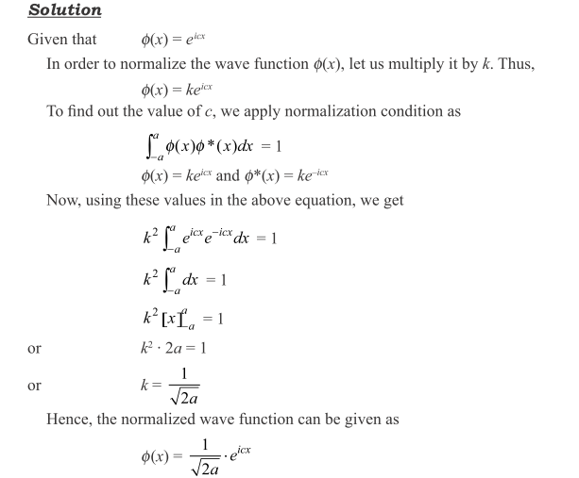
Example-2

Slide 16
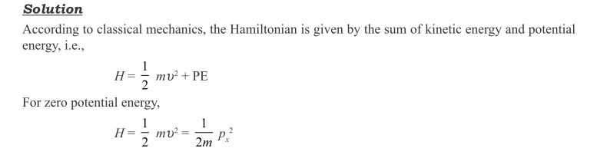
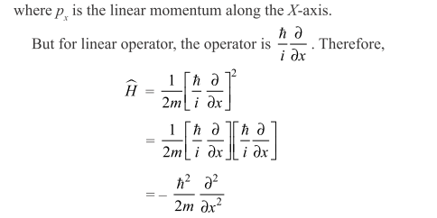
Example-3 Write the Hamiltonian operator of a free particle moving in one direction under the influence of zero potential energy.

Slide 17
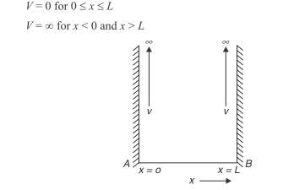
APPLICATIONS OF SCHRÖDINGER WAVE EQUATION de
Particle in a One-Dimensional Box.

Slide 18

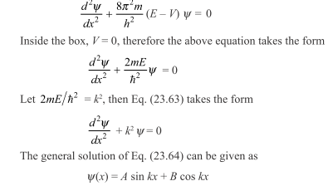
Application of Schrodinger Wave Equation Contd…
The Schrödinger wave equation for the particle is given by
Schrodinger wave equation in one dimension can be written as

Slide 19
Problem of the particle in the box Contd..
The values of A and B can be determined by applying the boundary conditions.
Since this particle cannot penetrate the walls and cannot exist outside the box, the probability of finding the particle (i.e., ᴪ) will be zero outside the box.
Hence, ᴪ = 0 at x = 0 and ᴪ = 0 at x = L
Applying these boundary conditions to we get
0 = A sin 0 + B cos 0 (because at x = 0, ᴪ = 0)
or B = 0

Slide 20
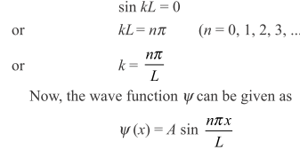
Problem of the particle in the box Contd..
Using the value of B =0 in the above equation we get ᴪ = A sin kx
Using the boundary condition, ᴪ = 0 at x = L, we get A sin kL = 0
In the above equation, either A is zero or sin kL is zero.
Since A is the amplitude of the wave, A ≠ 0. Hence, we get

Slide 21
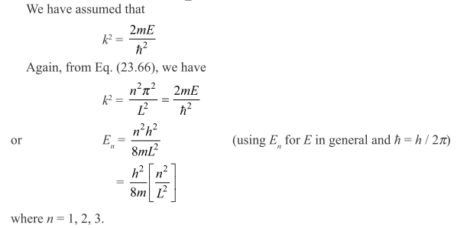
Problem of the particle in the box Contd..

Slide 22
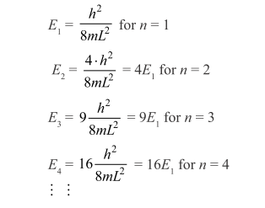
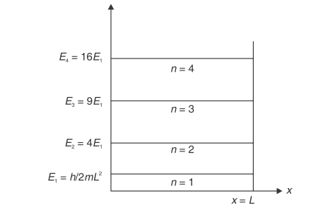
Problem of the particle in the box Contd..
It is clear from this expression that the particle has only discrete sets of values of energy, i.e., the energy of the particle is quantised.
The discrete energy levels of the particle in deep potential box have been shown in Fig.

Slide 23
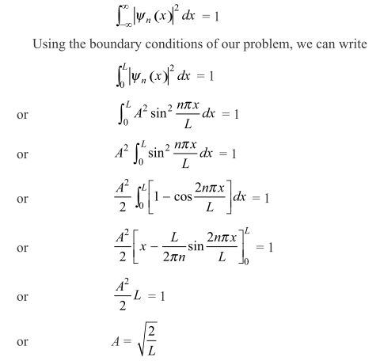
Problem of the particle in the box Contd..
We still require the exact value of constant A. To find the value of constant A, we apply normalization condition,
Using the value of A we get
ᴪ$(x)=\sqrt{\frac{2}{L}}$ Sin $\frac{nπx}{L}$

Slide 24
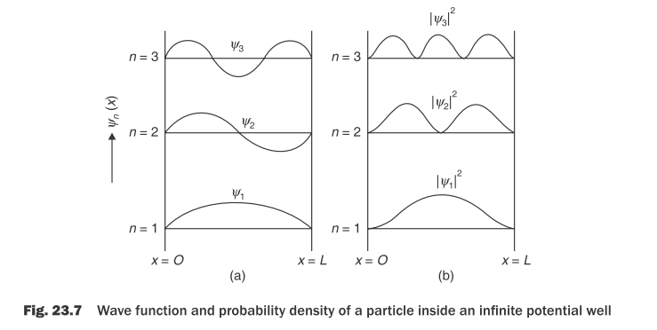
Probability Density Distribution

Slide 25
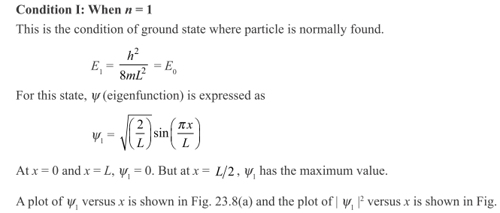
Physical Interpretation of Probability Density Distribution
For physical interpretation of probability density distribution, let us consider three conditions corresponding to n = 1, 2, and 3, respectively.

Slide 26
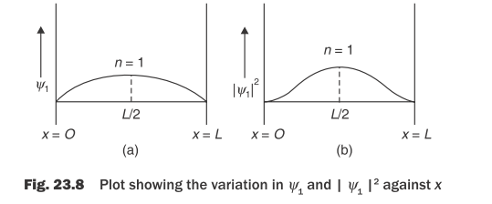
Physical Interpretation of Probability Density Distribution
From Fig. 23.8(b), it is clear that the probability of finding the particle inside the box is maximum at x = L/2, while it is zero at x = 0 and x = L.
We can conclude that in ground state, the probability of finding the particle is maximum at central region, while it is minimum at the walls of the box.

Slide 27
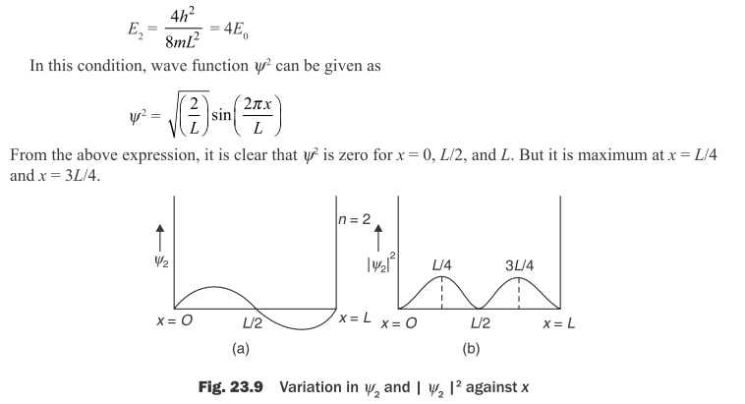
Condition II: When n = 2
This condition is known as first excited state . In this case, the energy of the particle can be given as

Slide 28
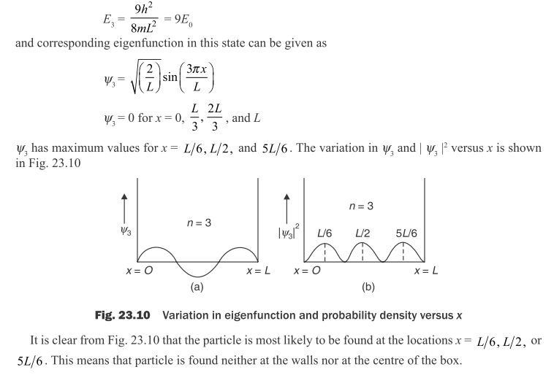
Condition III: When n = 3
Similar to above conditions, we can obtain the expression of energy for the second excited state which can be given as

Slide 29
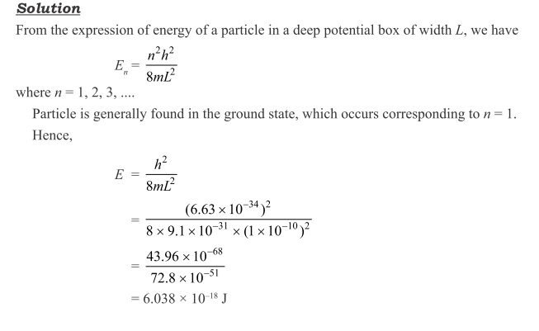


Slide 30
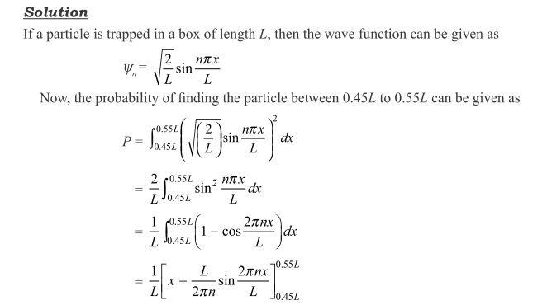
Find the probabilities of finding a particle trapped in a box of length L in the region from 0.45L to 0.55L for the ground state and the first excited state.

Slide 31
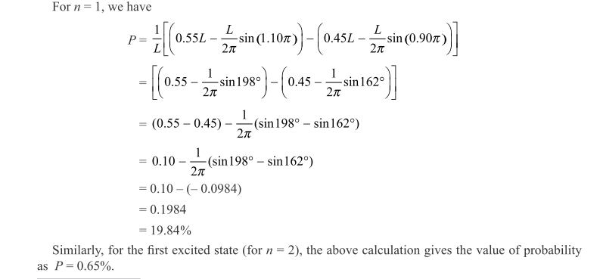

Slide 32
Assignment Based on this Lecture
Describe the wave function ᴪ.
Give the physical interpretation of wave function ᴪ .
Obtain the expression of Time independent Schrodinger wave equation.
Obtain the expression of Time dependent Schrodinger wave equation.

Slide 33
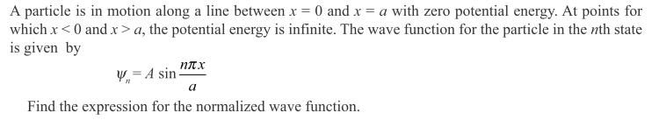
Assignment Based on this Lecture
Describe the problem of the particle in a box.
Obtain the expression of wave function ᴪ and energy for a particle in a box.
Explain the Physical interpretation of probability distribution of a particle.

Slide 34
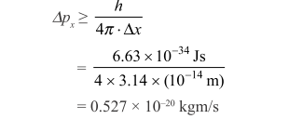
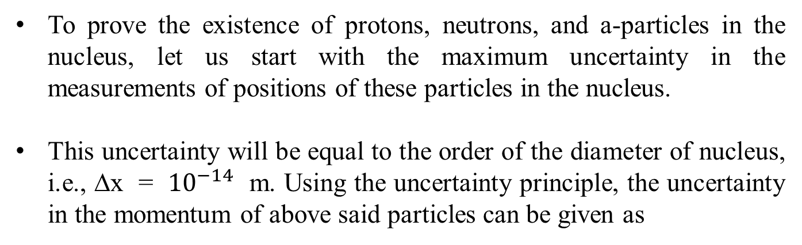
Existence of Protons, Neutrons, and α-particles in the Nucleus
To prove the existence of protons, neutrons, and a-particles in the nucleus, let us start with the maximum uncertainty in the measurements of positions of these particles in the nucleus.
This uncertainty will be equal to the order of the diameter of nucleus, i.e., ∆x = ${10}^{−14}$ m. Using the uncertainty principle, the uncertainty in the momentum of above said particles can be given as

Slide 35
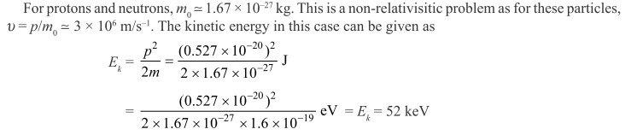
This value of this kinetic energy is smaller than the energies of the particles emitted by the nucleus. Hence, the particles such as protons and neutrons, or the particles heavier than these, can exist inside the nucleus.

Slide 36

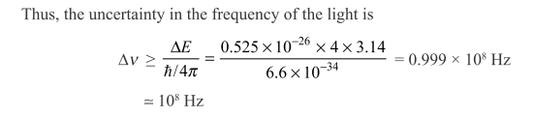
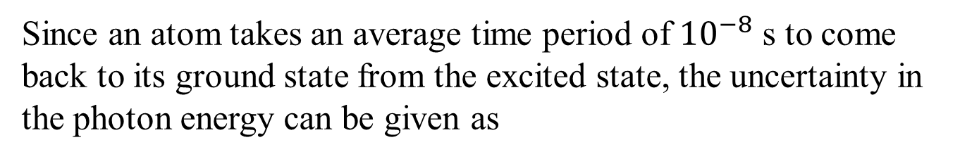
Radiation of Light from an Excited Atom
Since an atom takes an average time period of ${10}^{−8}$ s to come back to its ground state from the excited state, the uncertainty in the photon energy can be given as
The above value of ∆ν gives the maximum limit of accuracy with which one can determine the frequency of the radiation emitted by an atom.

Slide 37
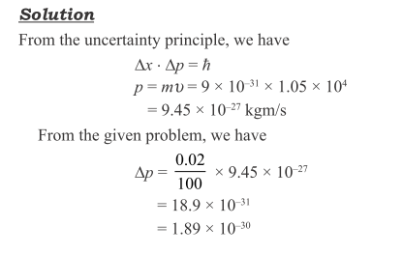
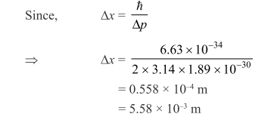

Slide 38
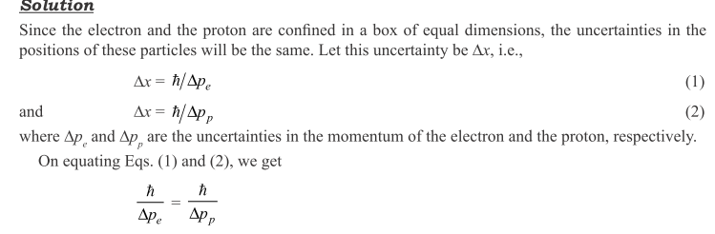
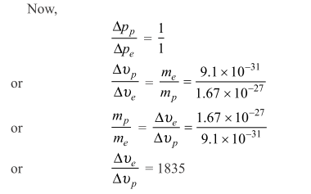

Slide 39
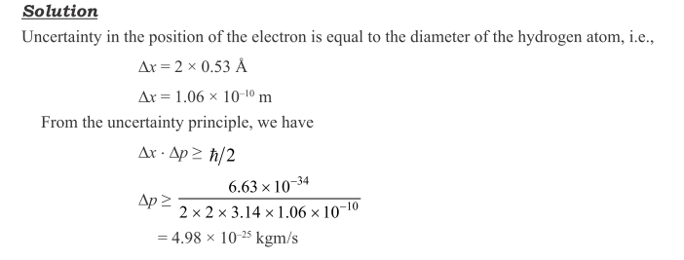
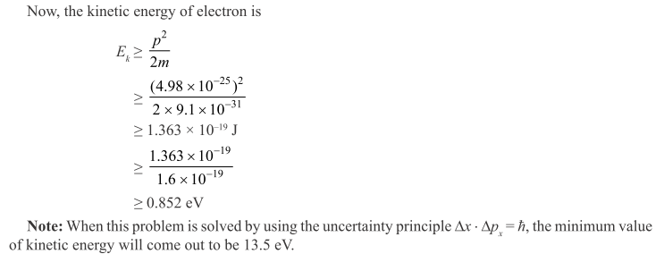

Slide 40

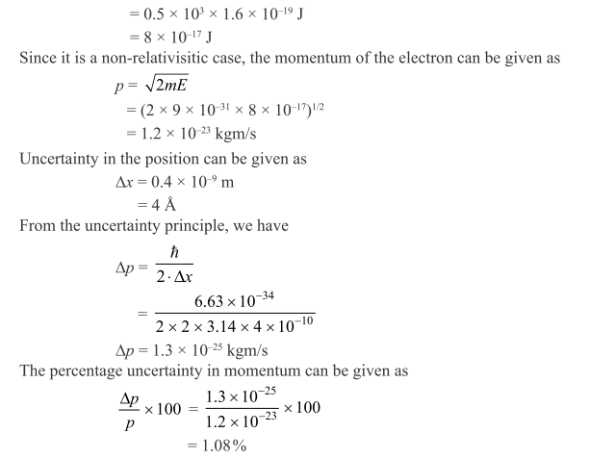

Slide 41
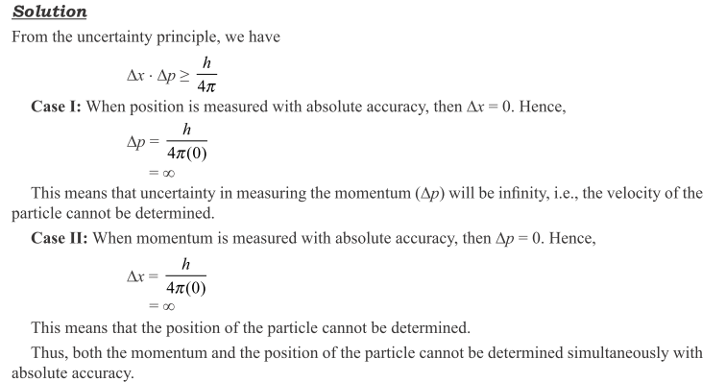

Slide 42
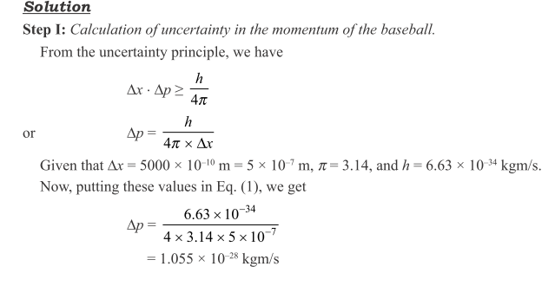
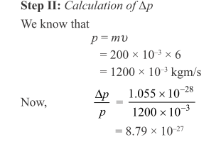

Slide 43
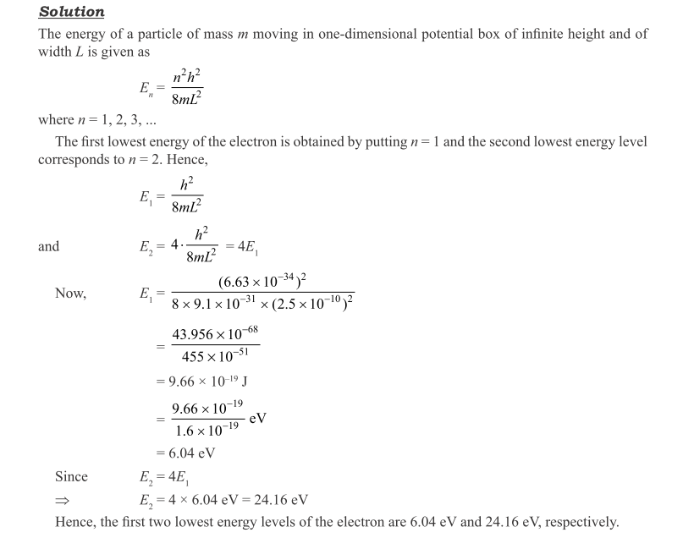

Slide 44
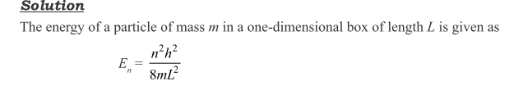
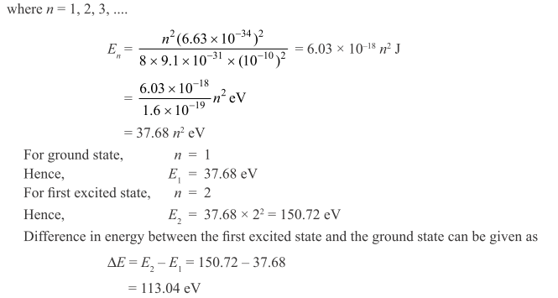

Slide 45
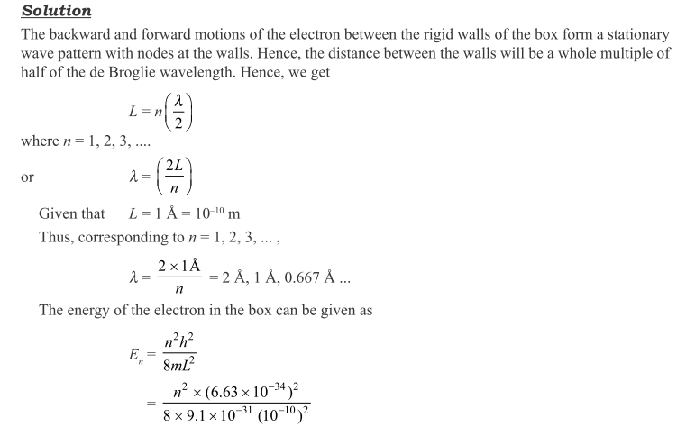
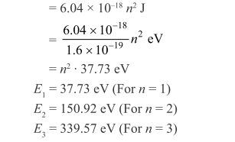

Slide 46
